Slide 1
TA Allocation Algorithm Implementation
eTA | Team 307
Project Sponsor: Computer Science and Engineering Department, University of California Merced
Mentor: Doctor Angelo Kyrilov

Slide 2
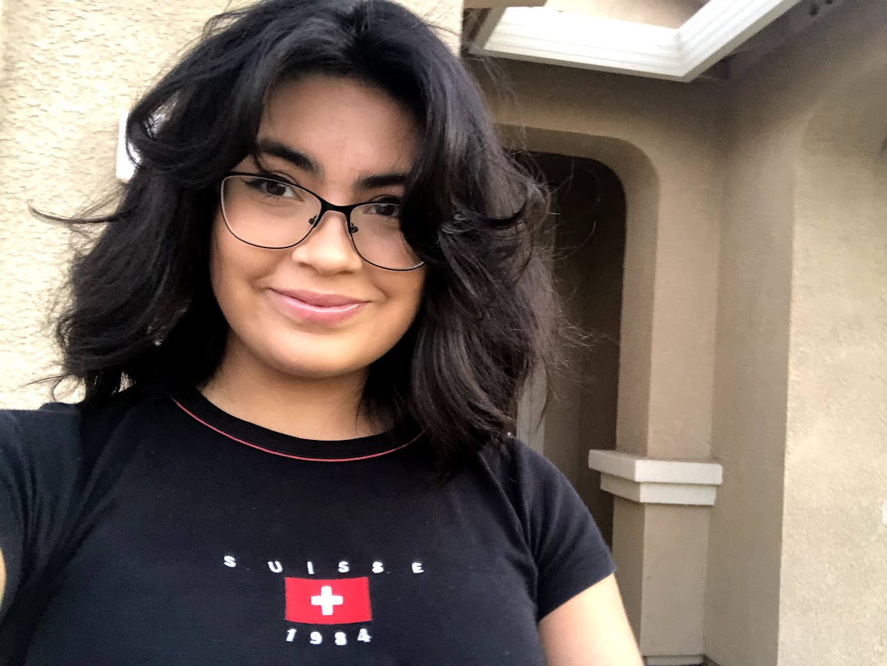
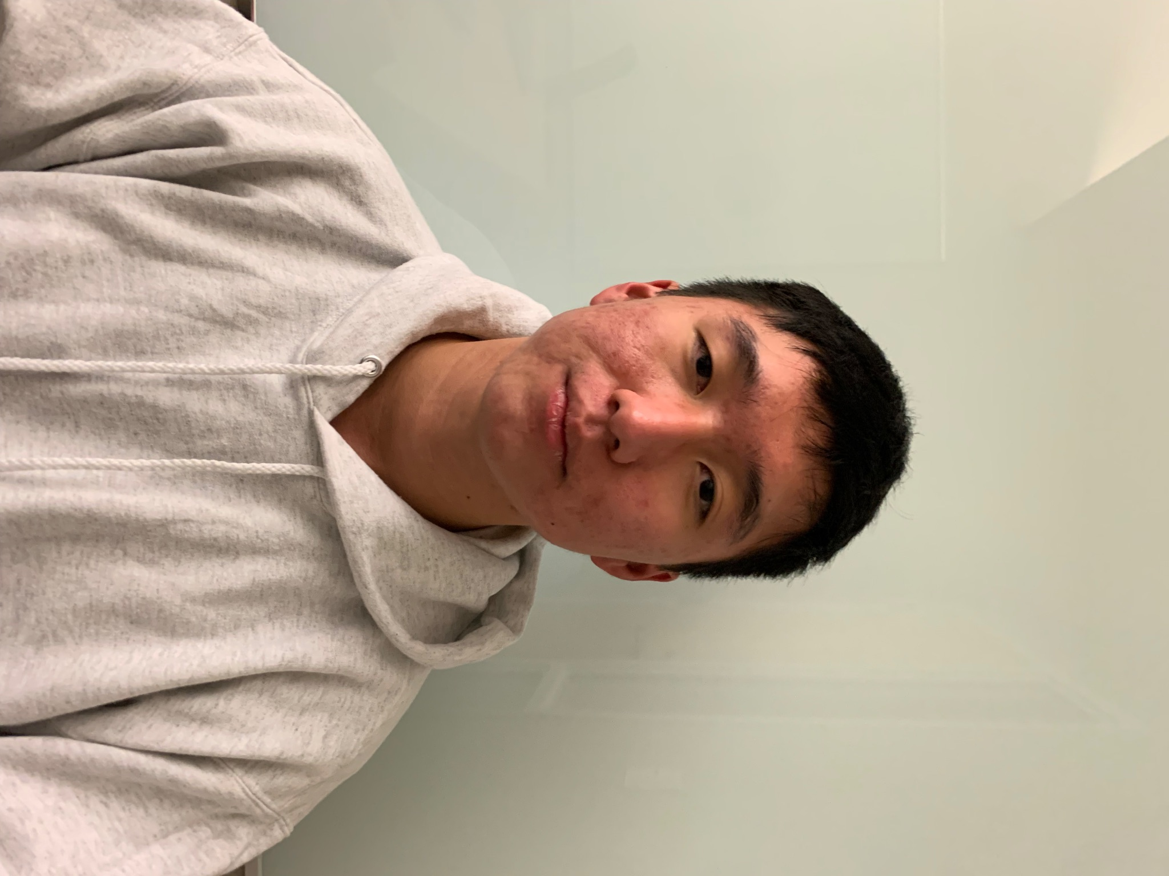
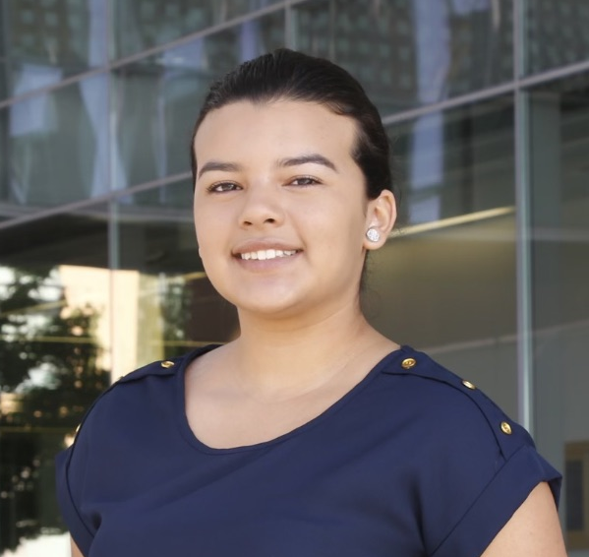



Meet the Team
Isabella Montoya
Project Lead
Backend Developer
Yee Thao
Full Stack Developer
Valeria Cortez
Frontend Developer
Lamine Sunga
Backend Developer
Harleen Mann
Frontend Developer
eTA (Team 307) | TA Allocation Algorithm Implementation | CSE Department UC Merced |

Slide 3
CONTEXT
Graduate Advisors
Teaching Assistant(TA)
TA Committee
Professors at UC Merced who advise Grad Student through research
Teaching Assistant positions filled by Graduate student to fund their graduate education. The position usually involves running labs, discussions, and grading assignments
A committee that assigns graduate students to TA positions
eTA (Team 307) | TA Allocation Algorithm Implementation | CSE Department UC Merced |
Notes:
Graduate Advisors
Professors @ the UC who pursues research with the help of Grad Students
TA
Teaching Assistant positions filled by Graduate student to fund their graduate education. The position usually involves running labs, discussions, and grading assignments
TA Committee
A committee that assign Grad students to TA positions

Slide 4
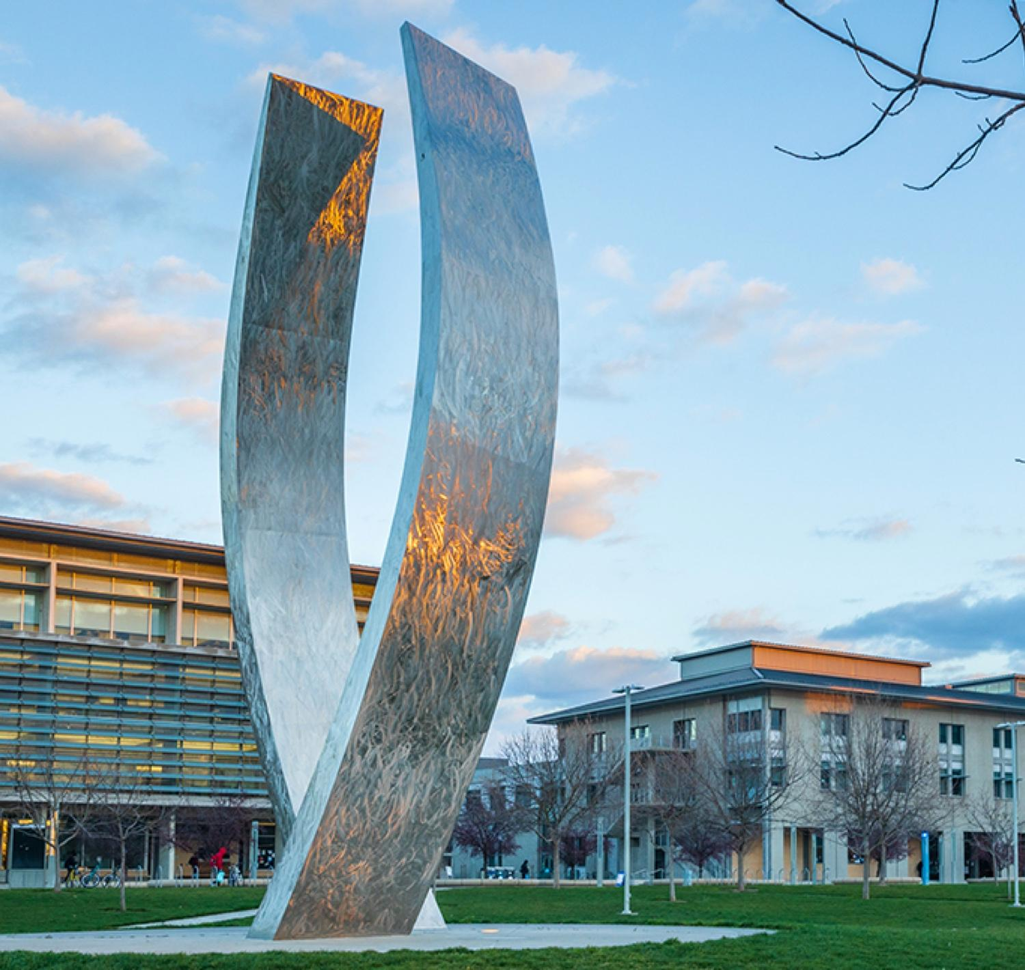
STAKEHOLDERS
Computer Science and Engineering Department at UC Merced
Advisors of Graduate Students
Graduate Students
eTA (Team 307) | TA Allocation Algorithm Implementation | CSE Department UC Merced |

Slide 5

PROBLEM
Inequality in Teaching Assistant (TA) position distribution in CSE department
Previously everyone who requested a TA position were granted one
Increase in demand for limited TA positions
eTA (Team 307) | TA Allocation Algorithm Implementation | CSE Department UC Merced |
Notes:
TA Position covers tuition for graduate students rather than their advisor applying for external funding
A rise of Graduate Student enrollment in Science of Engineering (SoE) department occurred resulting in an increase demand for limited TA positions
Now, not every graduate student is guaranteed a TA position

Slide 6
01
02
03
PROJECT GOALS
Create a database driven web application for the TA Committee
Committee should be able to allocate TAs with transparency and equity
Use a score algorithm based on the historical usage of TAship by a given advisor
eTA (Team 307) | TA Allocation Algorithm Implementation | CSE Department UC Merced |
Notes:
Describe transparency as transparency within the CSE department based on the TA positions already used by the advisors in the past so that it is fair to every advisor.
Equity: Based on previous usage of TA positions by the advisors. We developed these goal with our mentor

Slide 7
PLANNED REQUIREMENTS
Develop 3 user interface pages
Advisor, TA Committee, Admin
Security
Compatible with a cloud environment
Keep track of advisors’ usage history
Implement drag-drop functionality for TA assignment purposes
eTA (Team 307) | TA Allocation Algorithm Implementation | CSE Department UC Merced |
Notes:
Explain security aspect: encrypted databases, secure connection https, password req

Slide 8
DELIVERED REQUIREMENTS
Develop 3 user interface pages
Security
Compatible with a cloud environment
Keep track of advisors’ usage history
Implement drag-drop functionality for TA assignment purposes
eTA (Team 307) | TA Allocation Algorithm Implementation | CSE Department UC Merced |
Notes:
For bullet point 2: Say “Created a secure application”

Slide 9
BONUS FEATURES
(By high to low priority)
Upload semester class schedule
Locking TA Committee interface
“Create group” feature for TA Committee
eTA (Team 307) | TA Allocation Algorithm Implementation | CSE Department UC Merced |

Slide 10



PLATFORMS
Firebase
Express.js
React
Node.js
eTA (Team 307) | TA Allocation Algorithm Implementation | CSE Department UC Merced |
Notes:
Node.js server side application with react front end due to a recommendation from project mentor and are industry standards. Firebase database: No-SQL database due to it’s built in security features,Reliable & Extensive Databases, and learning opportunity

Slide 11

DEMO
eTA (Team 307) | TA Allocation Algorithm Implementation | CSE Department UC Merced |
Notes:
Explicitly says “And that concludes are demo”

Slide 12
TECHNICAL CHALLENGES
Learning new development tools
Implementing drag and drop
Revised design based on mentor’s suggestions
Backend dependency on frontend and vice-versa
eTA (Team 307) | TA Allocation Algorithm Implementation | CSE Department UC Merced |
Notes:
How did we address it?
What did we learn?

Slide 13
TEAM CHALLENGES
Disagreements on development tools
Finding ways to communicate with one another
Establishing a workflow on based everyone’s working style
eTA (Team 307) | TA Allocation Algorithm Implementation | CSE Department UC Merced |

Slide 14
PITFALLS TO AVOID
Develop strong decision making process
Understanding deadlines and priorities
Communicate effectively
eTA (Team 307) | TA Allocation Algorithm Implementation | CSE Department UC Merced |
Notes:
- advise to other developers who might develop the same application
- have strong decision making process
- make sure you understand priorities, communicate with mentor, new changes are identified early

Slide 15
FUTURE WORK
Short Term
Long Term
Application optimization
Improve the UI design
Add Single Sign-On
Locking TA Committee interface
“Create group” feature for TA Committee
Deploy to different UC Merced departments and other schools
Use for other operations
Ex: Assigning roles by a manager
eTA (Team 307) | TA Allocation Algorithm Implementation | CSE Department UC Merced |

Slide 16
CONCLUSION
Being able to make assignments for TAs in a fraction of the time
Convenient tool for users to avoid mistakes
Secure login and connection
eTA (Team 307) | TA Allocation Algorithm Implementation | CSE Department UC Merced |
Notes:
- better conclusion, current way is cumbersome, maintenance to excel sheet, errors in assignment, we designed a system with convenience, ways to avoid mistake, built in security

Slide 17
TA Allocation Algorithm Implementation
eTA | Team 307
Isabella Montoya
imontoya3@ucmerced.edu
Yee Thao
yeethao1234@gmail.com
Valeria Cortez
valeriacortez511@gmail.com
Lamine Sunga
laminesunga@gmail.com
Harleen Mann
harleenkaurmann8@gmail.com
eTA (Team 307) | TA Allocation Algorithm Implementation | CSE Department UC Merced |

